Slide 1
Object Oriented Programming
Presented By:
Bishal Phuyal
BIM 1st Sem
Section “A”
Roll No: 09

Slide 2
Flow of presentation:
Introduction
Why OOP than procedureal language.
Four functions of OOP
Bob Martin’s 5 Principles.
Pros and cons of OOP.
Uses of OOP.

Slide 3
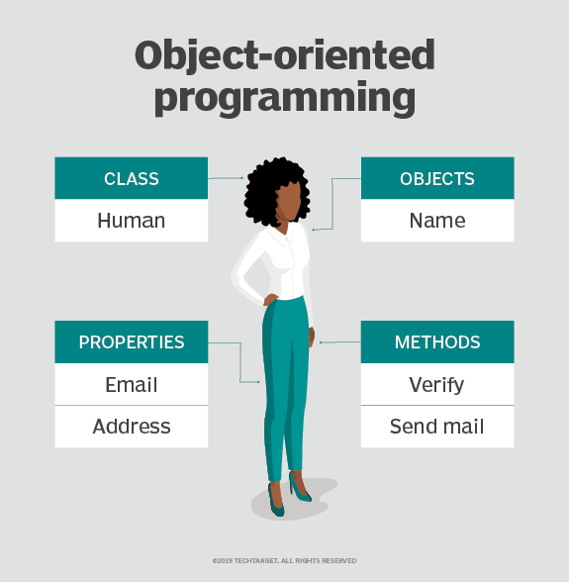
Introduction.
OOP is the paradigm of writing code in structured way.
Two main concept:
1. Class : User-defined data type.
2. Object : Grouping of functions and properties

Slide 4
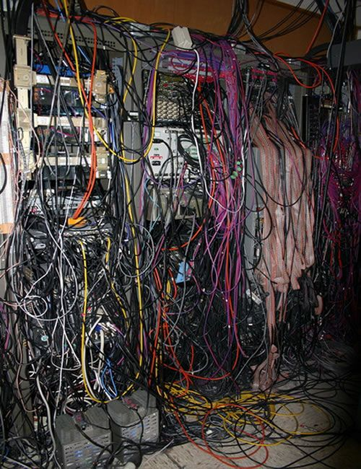
Procedural Language.
Simple and straight forward language.
Uses functions as the main object.
Good for small but not for the big programs
Spaghetti Code.
To solve OOP was invented during 1960’s

Slide 5
Four Pillars of OOP

Slide 6
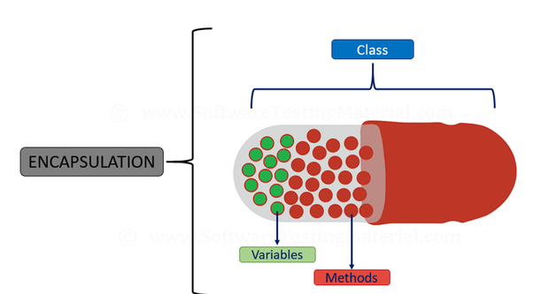
1. Encapsulation.
Grouping the properties and methods as one object.
-Reduces complexity
Increase reusuability
Taking Example as this seminar hall.
Properties: Big, Desks, People, good sound system.
Methods : seminar(), presentation(), workshop(),
and counseling().

Slide 7
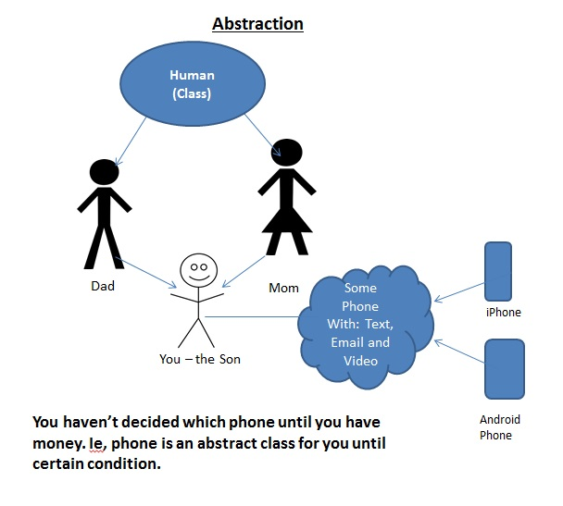
2. Data Abstraction
Hidding the unnecessary and complex part inside.
-Reduces the complexity.
-decrease the impact of change.
Giving an example of a remote controller

Slide 8
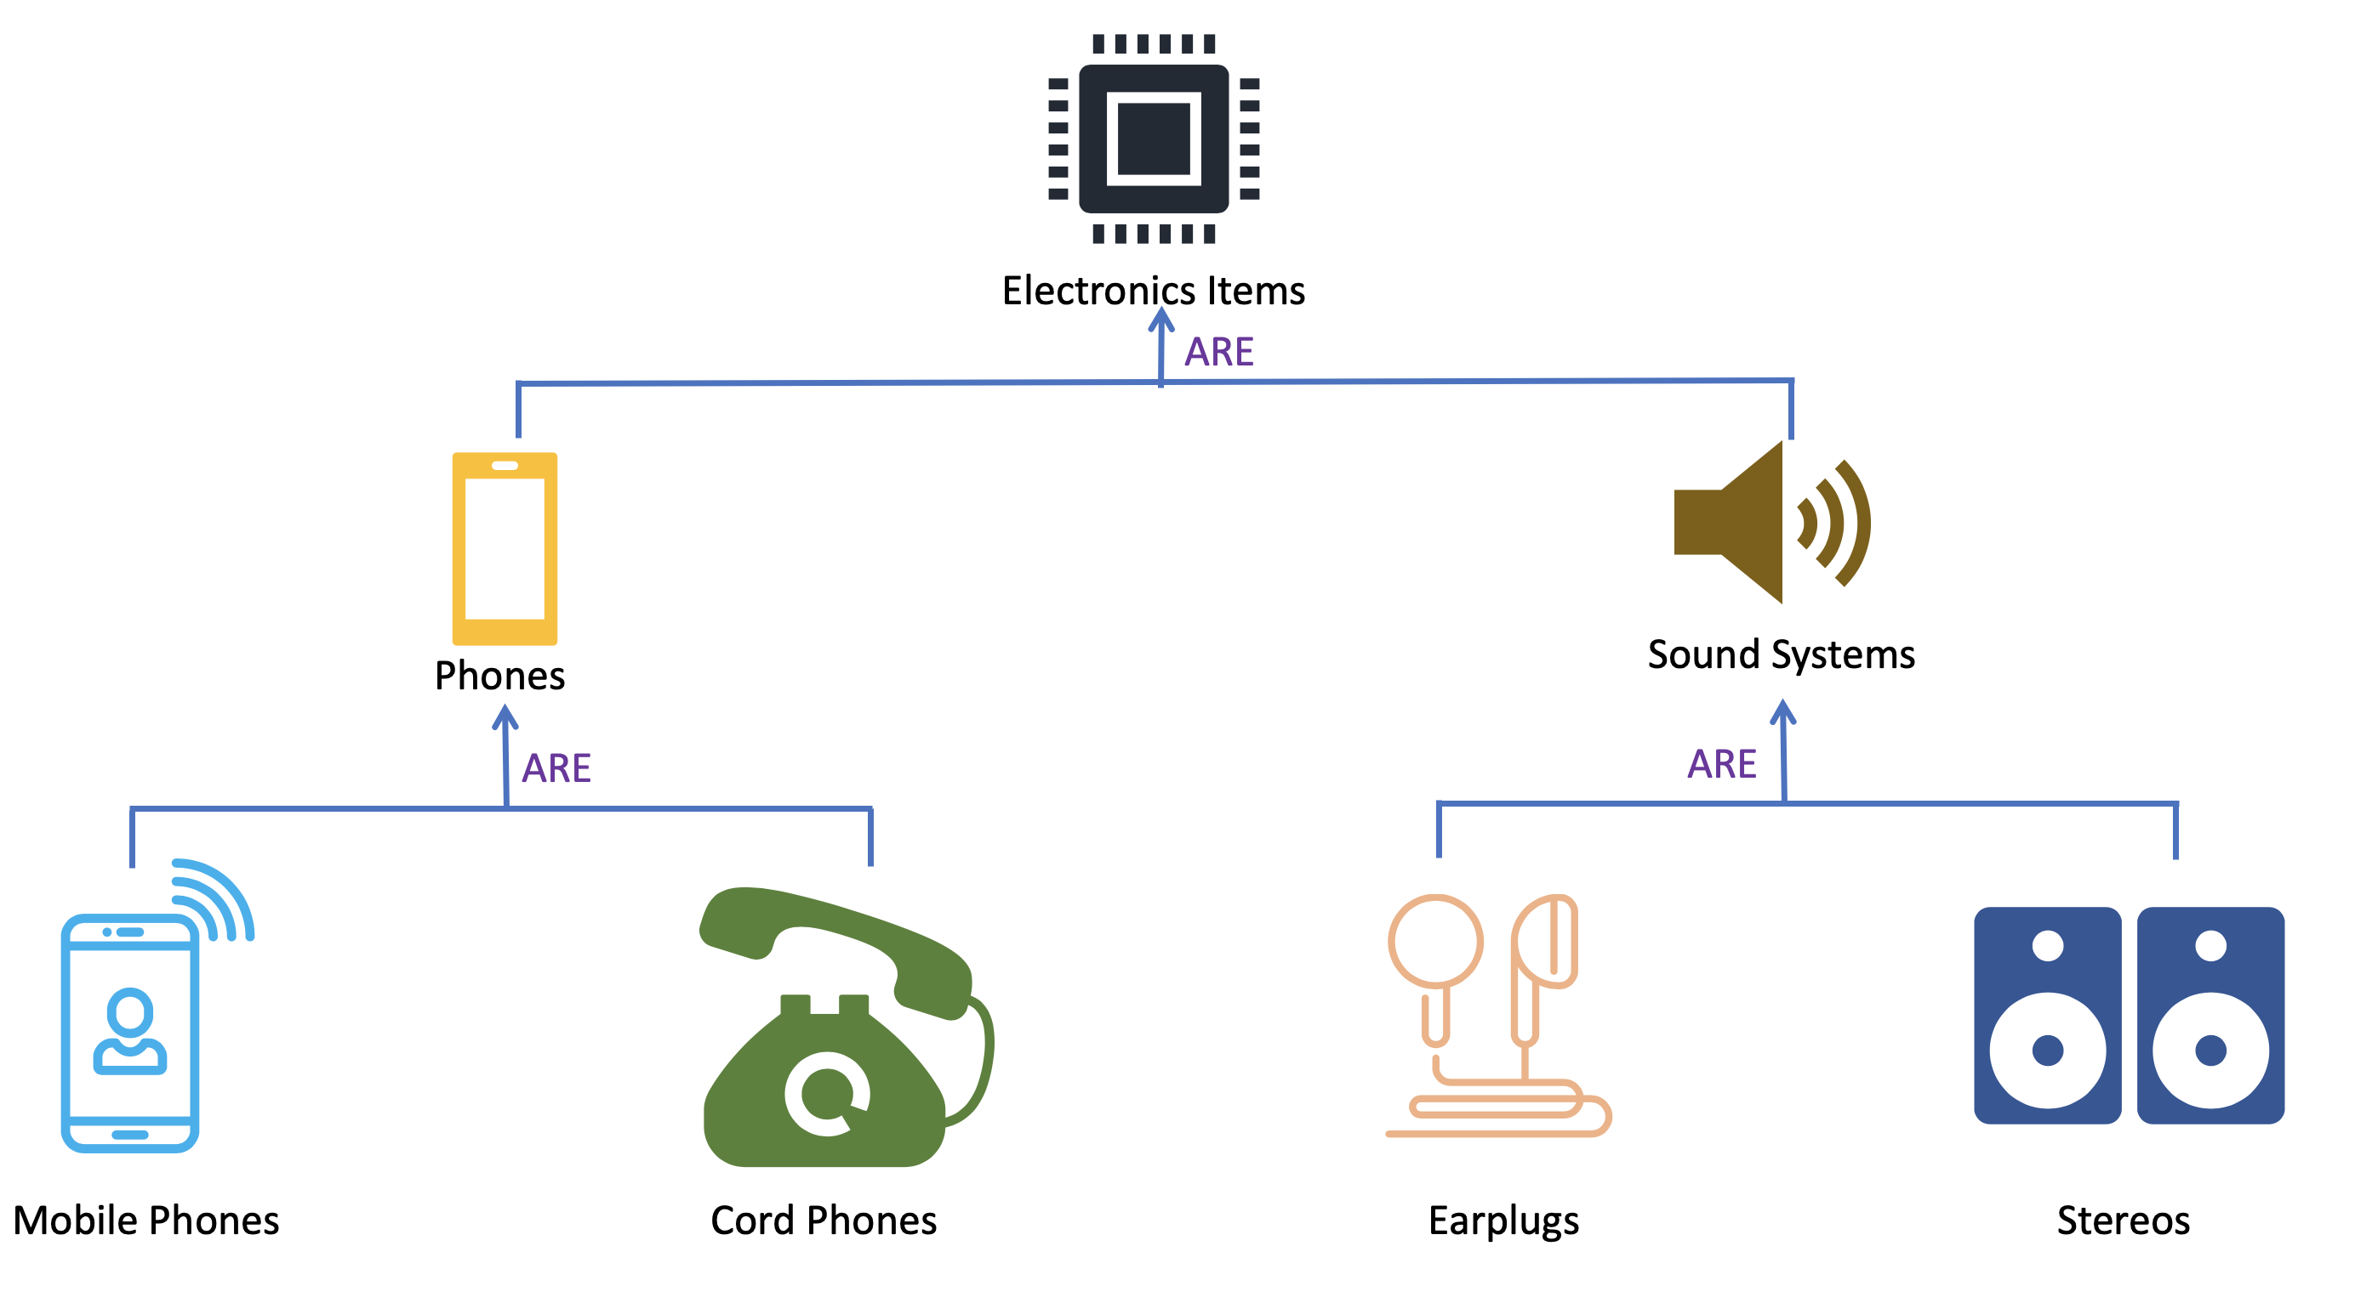
3. Inheritance
mechanism in which one class acquires the property of another class
Reduces the redundant code.

Slide 9
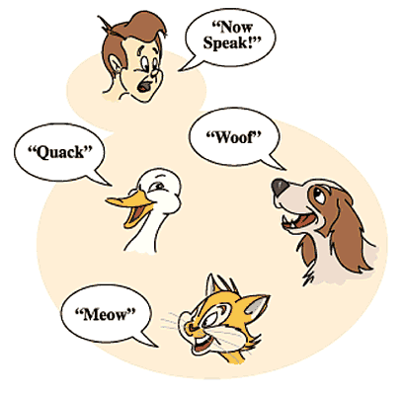
4. Polymorphism
Having many forms.
Get rid of if-else and switch cases.
-Example can use function speak() to access to “Quack”, “Woff”, “Meow” and “Now speak”.

Slide 10
Uncle Bob martin 5 principle.
Single Responsibility Principle: class should have one reason to change.
Open close Principle: You should be able to extend a classes behavior, without modifying.
Liskov Substitution Principle: Derived classes must be substitutable to base classes.
Interface Segregation Principle: Make fine grained interfaces that are client specific
Dependency Inversion Principle: Depend on abstraction, not on concretions.

Slide 11
Pros and Cons:
Pros:
easily reused in other programs .
Easier for maintenance.
complex systems of real world can be converted into software solutions.
easy to implement.
easily extensible.
Cons
Larger program size.
Steep learning curve.
Not suitable for all types of problems.
Data duplication might occur.

Slide 12
Uses of OOP
Client-Server Systems
Object-Oriented Databases
AI Expert Systems
Real-Time System Design
Hypertext And Hypermedia

Slide 13
Thank You

